Slide 1
Fundations of Generative AI
Text Classification

Slide 2
Foundations of GenAI
Feed forward Networks

Slide 3
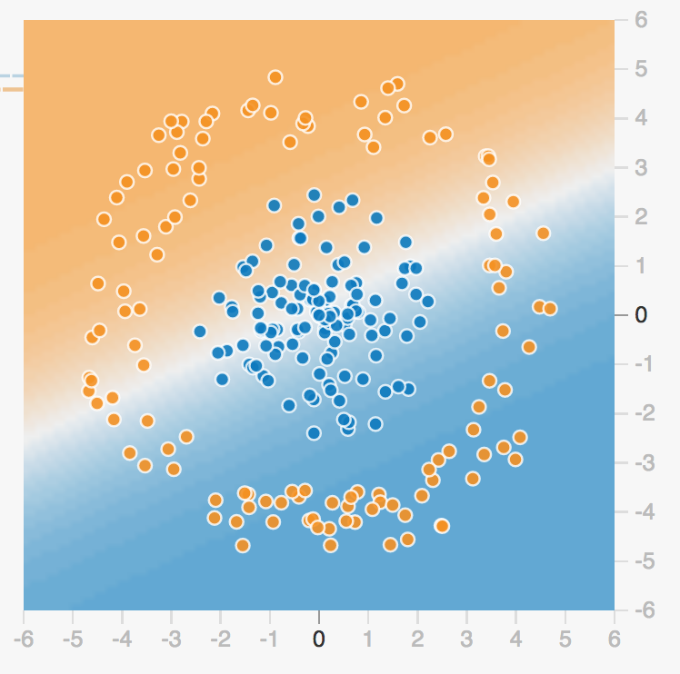
Separability
Text Classification
Can we separate this points to
Classify correctly the class
(seniment, category, etc… ?)
Playground

Slide 4
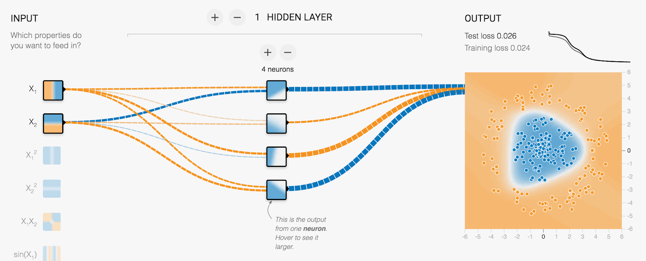
More neurons == nonlinearities
Text Classification
Playground

Slide 5
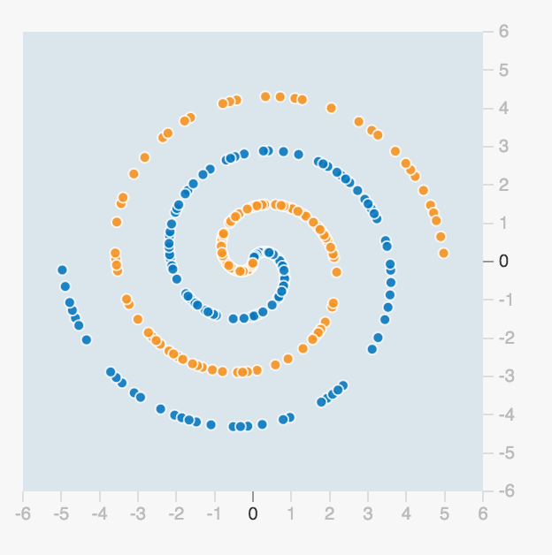
How can we do to split these?
Text Classification

Slide 6
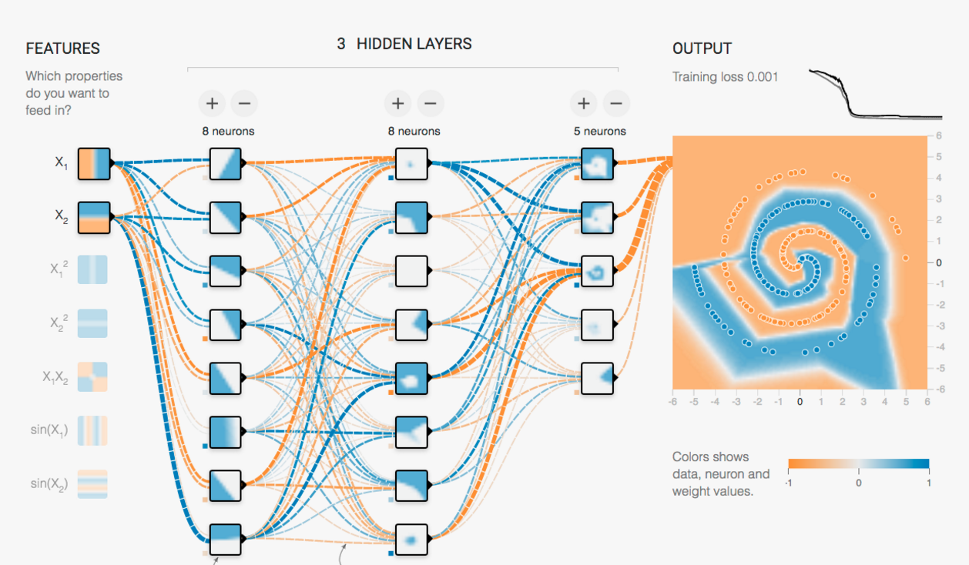
Again, mini-lines help!
Text Classification
Playground

Slide 7
In code
Text Classification
model = nn.Sequential(
nn.Embedding(vocab_size, embedding_dim),
nn.Linear(embedding_dim, 100),
nn.ReLU(),
nn.Linear(100, 50),
nn.ReLU(),
MeanLayer(),
nn.Linear(50, 4),
nn.Softmax()
)
Define a
Sequential
model

Slide 8
In code
Text Classification
model = nn.Sequential(
nn.Embedding(vocab_size, embedding_dim),
nn.Linear(embedding_dim, 100),
nn.ReLU(),
nn.Linear(100, 50),
nn.ReLU(),
MeanLayer(),
nn.Linear(50, 4),
nn.Softmax()
)
Add an embedding layer to the model

Slide 9
In code
Text Classification
model = nn.Sequential(
nn.Embedding(vocab_size, embedding_dim),
nn.Linear(embedding_dim, 100),
nn.ReLU(),
nn.Linear(100, 50),
nn.ReLU(),
MeanLayer(),
nn.Linear(50, 4),
nn.Softmax()
)
Add a fully connected layer of 100 hidden units

Slide 10
In code
Text Classification
model = nn.Sequential(
nn.Embedding(vocab_size, embedding_dim),
nn.Linear(embedding_dim, 100),
nn.ReLU(),
nn.Linear(100, 50),
nn.ReLU(),
MeanLayer(),
nn.Linear(50, 4),
nn.Softmax()
)
Add the activation

Slide 11
In code
Text Classification
model = nn.Sequential(
nn.Embedding(vocab_size, embedding_dim),
nn.Linear(embedding_dim, 100),
nn.ReLU(),
nn.Linear(100, 50),
nn.ReLU(),
MeanLayer(),
nn.Linear(50, 4),
nn.Softmax()
)
Average across words

Slide 12
In code
Text Classification
model = nn.Sequential(
nn.Embedding(vocab_size, embedding_dim),
nn.Linear(embedding_dim, 100),
nn.ReLU(),
nn.Linear(100, 50),
nn.ReLU(),
MeanLayer(),
nn.Linear(50, 4),
nn.Softmax()
)
Final softmax

Slide 13

LAB
Text Classification
News Classifier with NLP
Use a feed forward neura network to classify news headlines!

Slide 14

Summary
Text Classification
Adding more layers to neural networks results in a nonlinear decision boundary.
This way we can make classification on text.
FFN have ton of parameters, so they tend to not scale when the vocal is big, or the training set is complex.
One thing you can do as homework is add fine-tuning of a pertained embedding layer to imporve results!

